Slide 1
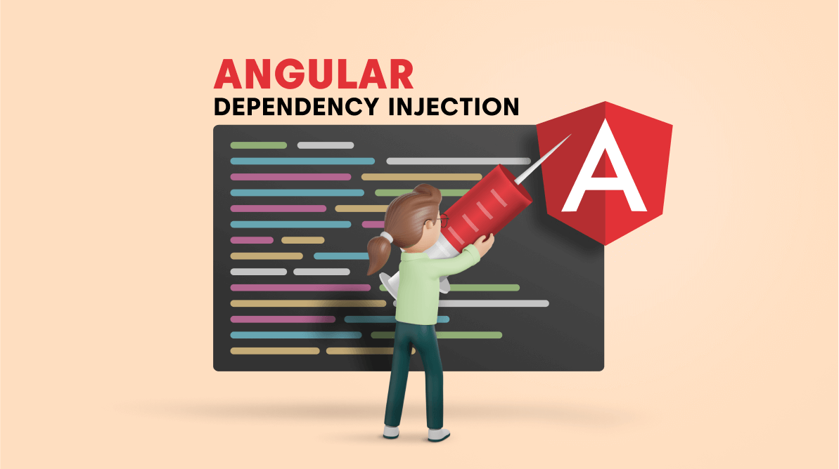

Slide 2



Peter Eijgermans
@EijgermansPeter

Slide 3

Contents
What and why DI?
DI in action
Module and Element injector hierarchies
Lazy loading Modules and DI
Resolution Modifiers
Dependency Providers

Slide 4
What is a dependency ?
A
B
C
Notes:
When module A in an application needs module B to run, then module B is a dependency of module A.
Realistically when writing applications we can’t get away from building numerous dependencies between parts of our code.

Slide 5
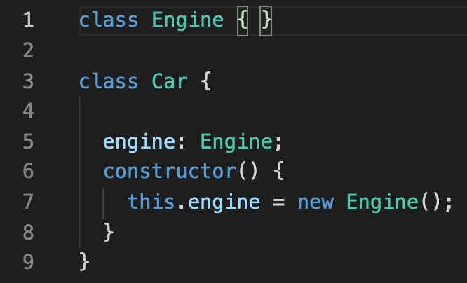
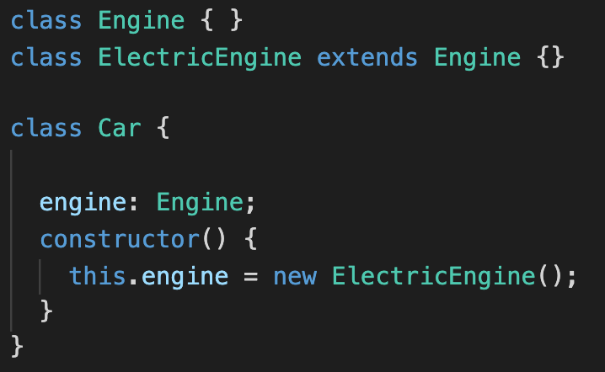
The Problem
Notes:
Here we see here that the Engine is a dependency of Car !
Inflexible
Hard to re-use. It hardcodes the Engine
How would you use this class if you wanted to use or Test another Engine provider?

Slide 6
The Problem
Violates Single responsibility
Not flexible
Dependency is tightly coupled
Hard to re-use
Hard to test
Notes:
Violates Single responsibility → Car is here responsible for engine creation

Slide 7
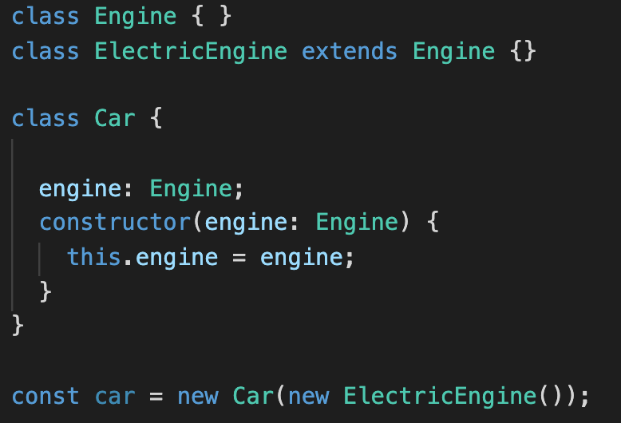
Solution
Notes:
Previously the Car constructor was responsible for creating an instance of its dependency the Engine.
Now something else is responsible for creating the instance of Engine and then passing it into the Car via its constructor.

Slide 8
Solution
Car is not responsible for engine creation
Easy to replace engine implementation
Easy to test
Easy to re-use
Dependency is decoupled
Notes:
Easy test or re-use
We can pass in a dummy Engine or mockEngine

Slide 9
Inversion of Control = IoC
Notes:
This idea of moving the responsibility of creating concrete instances of dependencies to something else is called Inversion of Control, or IoC.
The specific design pattern for implementing IoC above is called Dependency Injection

Slide 10
What is DI?
Dependency injection is a programming technique
that makes a class independent of its dependencies
Notes:
Dependency Injection is a software design in which components are given their dependencies instead of hard coding them within the component. It relieves a component from locating the dependency and makes dependencies configurable. It also helps in making components reusable, maintainable and testable.

Slide 11
Dependency Injection in Angular

Slide 12
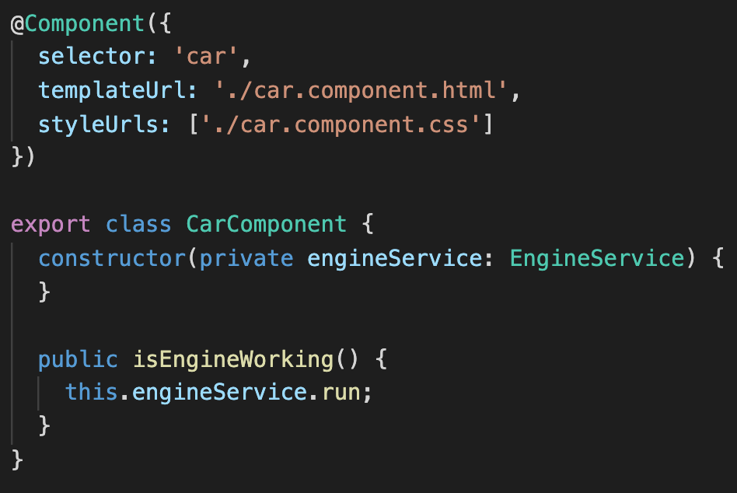
Dependency Injection in Angular

Slide 13

Injector
Injector
Responsible for creation of the class instance
And inject it into the constructor of the object

Slide 14
Dependency Injection in action !
https://www.typescriptlang.org/play

Slide 15
class EngineService {
run() {
console.log('Engine is running!')
}
}
class CarComponent {
constructor(private engineService: EngineService) {
}
public isEngineWorking() {
this.engineService.run();
}
}
class Injector {
private _container = new Map();
constructor(private _providers: any[]) {
this._providers.forEach(service => this._container.set(service, new service()))
}
get(service: any) {
const serviceInstance = this._container.get(service);
if (!serviceInstance) {
throw Error('No provider found !');
}
return serviceInstance;
}
}
// Usage in application
const providers = [EngineService];
const injector = new Injector(providers);
const component = new CarComponent(injector.get(EngineService));
component.isEngineWorking();

Slide 16
Usage simplified
Provide services
const providers = [EngineService, TiresService];
const injector = new Injector(providers);
const component = new CarComponent(injector.get(EngineService));
component.isEngineWorking();
Notes:
Also the Provide GasEngineService ⇒ and Test it !

Slide 17
How to provide services in Angular?

Slide 18
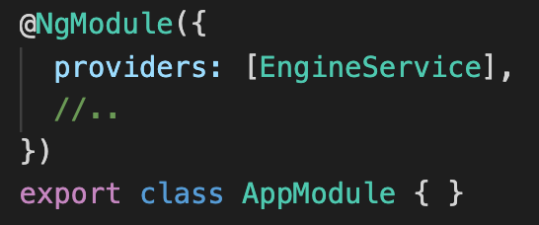
Provide Service in NgModule

Slide 19
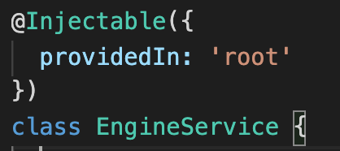
Provide Service in root
Tree-shakable
Notes:
Use the ProvidedIn root option, when you want to register the application-level singleton service.
Tree-shaking,: remove the service from the final bundle if the app does not use it → smaller bundle sizes

Slide 20
Two injector hierarchies
Element Injector hierarchy
Module Injector hierarchy
Notes:
Angular Creates not two injector trees when the app starts:
Module Injector tree is for Modules (@NgModule)
Element Injector tree is for DOM Elements like Components & Directives
Purpose hierarchies? Scope/AVAILABILTY of injected services ⇒ where can we use it in the application ? – Application wide or only at the scope of the component?

Slide 21
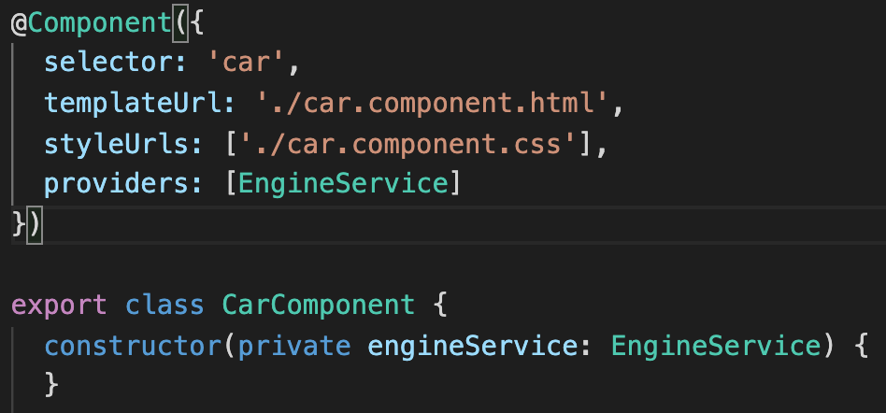
Two injector hierarchies
Element Injector hierarchy
Module Injector hierarchy
@Component() @Directive()
@NgModule() @Injectable()
Notes:
Module Injector hierarchy
We register the Module level services in two ways
Using The Providers Metadata of the @NgModule()
Using the @Injectable() Decorator with providedIn : root in the service itself
Element Injector hierarchy
Created implicitly at each DOM element.
You configure it in the providers property on @Directive() or @Component().

Slide 22
Module Injector Hierarchy

Slide 23
Root Injector
Services which where configured in non-Lazy @NgModule
and @Injectable annotations with provicedIn root and any
Notes:
See: https://www.tektutorialshub.com/angular/providedin-root-any-platform-in-angular/#google_vignette
Root injector -
Both configs will make the Services as SINGLETON available to the entire application.

Slide 24
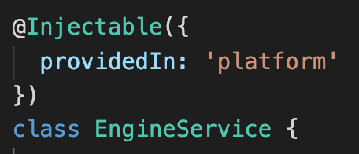
Platform Injector
Created when we call PlatformBrowserDynamic()
Root Injector
Services which where configured in non-Lazy @NgModule
and @Injectable annotations with provicedIn root and any
Notes:
A special singleton platform injector shared by all applications on the page.
This is a useful injector if you have multiple Angular Apps running on a single page.
Example: Multiple Angular Elements, where they can share a single instance of service between them.

Slide 25
Null Injector
Throws error if Angular tries to find service here
Platform Injector
Created when we call PlatformBrowserDynamic()
Root Injector
Services which where configured in non-Lazy @NgModule
and @Injectable annotationswith provicedIn root and any

Slide 26
Null Injector
Throws error if Angular tries to find service here
Platform Injector
Created when we call PlatformBrowserDynamic()
Root Injector
Services which where configured in non-Lazy @NgModule
and @Injectable annotations with provicedIn root and any
Child Injector
Injector is created for every Lazy-loaded module
Notes:
Child injector
Injector instance is created for every Lazy-loaded module
Angular creates them only when it loads them via ROUTINGS.
They are configured with the providers from the following locations.
Providers metadata of @NgModule of the Module being Lazy loaded
All the services which have providedIn metadata with value any in their @Injectable() decorator

Slide 27
If you provide some service in a eagerly loaded (non lazy) @NgModule
it will be added to the root injector which makes it
available across the whole application

Slide 28
Eagerly loaded Modules
versus
Lazy loaded Modules

Slide 29
Availability provided Singleton services
Provide a service using: | Eagerly loaded Modules | Lazy loaded Modules
@NgModule (root Module and imported) | Application-level | Own instance available in every Lazy Module
@Injectable with providedIn: any | Application-level | Own instance available in every Lazy Module
@Injectable with providedIn: root | Application-level and tree-shakable | Application-level and tree-shakable
@Injectable with providedIn: platform | Platform-level | Platform-level
@Injectable with providedIn: ‘LazyModule’ | error | Available in Lazy Module
@Injectable() without provideIn | Error no provider ! | Own instance available in every Lazy Module

Slide 30
Eagerly loaded modules
Lazy loaded modules
AppModule
EngineService
Produkt Module
EmployeeModule
EngineService
DepartmentModule
EngineService
Notes:
With provideIn Any, all eagerly loaded modulea share a singleton instance . Howver , lazy loaded modules each get their own unique instance, as shoen in the following diagram

Slide 31
Element Injector Hierarchy
Notes:
Element Injector hierarchy
Created implicitly at each DOM element.
You configure it in the providers property on @Directive() or @Component().

Slide 32
Provide Service at Component/Directive level
You get a new instance of the service with each new instance of that component
Notes:
Service is visible for Roor Component and Child comp

Slide 33
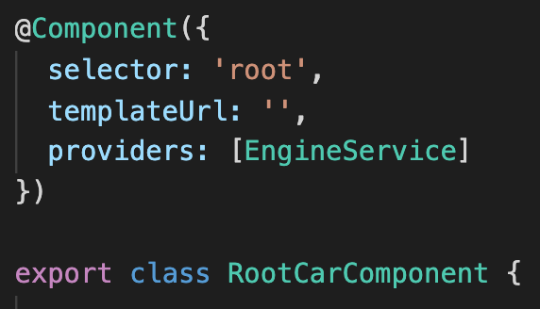
Element Injector
Services which where configured in @Component
and @Directive annotations

Slide 34
Element Injector
Services which where configured in @Component
and @Directive annotations
Child Element Injector

Slide 35
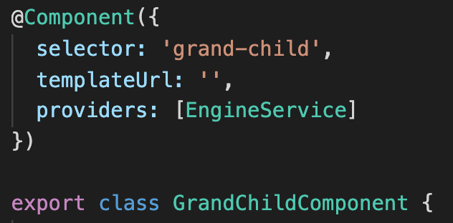
Element Injector
Services which where configured in @Component
and @Directive annotations
Child Element Injector
Grand Child Element Injector

Slide 36
Dependency Resolution

Slide 37
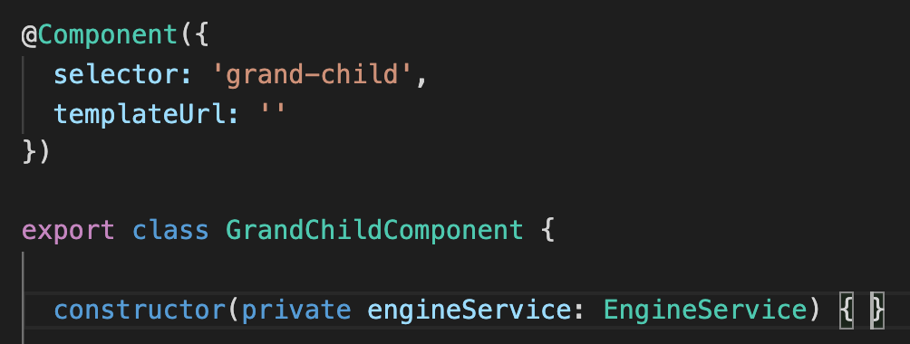
Element Injector Hierarchy
Module Injector Hierarchy
Element Injector
Services which where configured in @Component
and @Directive annotations
Null Injector
Throws error if Angular tries to find service here
Platform Injector
Created when we call PlatformBrowserDynamic()
Root Injector
Services which where configured in
non-Lazy @NgModule
and @Injectable annotations
Child Element Injector
Grand Child Element Injector

Slide 38
Element Injector Hierarchy
Module Injector Hierarchy
Element Injector
Services which where configured in @Component
and @Directive annotations
Null Injector
Throws error if Angular tries to find service here
Platform Injector
Created when we call PlatformBrowserDynamic()
Root Injector
Services which where configured in
non-Lazy @NgModule
and @Injectable annotations
Child Element Injector
Grand Child Element Injector
Notes:
Inject EngineService instance from RootCarComponent Injector, into grand-child Component

Slide 39
Element Injector Hierarchy
Module Injector Hierarchy
Element Injector
Services which where configured in @Component
and @Directive annotations
Inject EngineService instance from RootCarComponent Injector, into grand-child Component
Null Injector
Throws error if Angular tries to find service here
Platform Injector
Created when we call PlatformBrowserDynamic()
Root Injector
Services which where configured in
non-Lazy @NgModule
and @Injectable annotations
Child Element Injector
Grand Child Element Injector
Notes:
Module Injector hierarchy
Configure a Module Injector in this hierarchy using an @NgModule() or @Injectable() annotation.
https://www.tektutorialshub.com/angular/providedin-root-any-platform-in-angular/#google_vignette

Slide 40
What if the dependency could not be resolved
in the Element Injector tree?

Slide 41
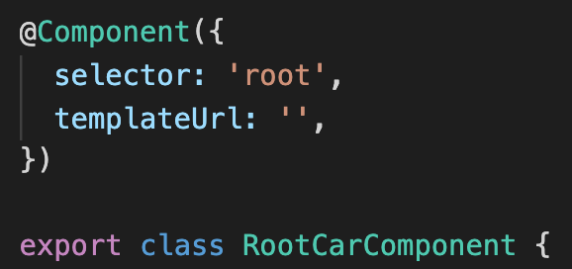
Element Injector Hierarchy
Module Injector Hierarchy
Element Injector
This component has no providers configured
Null Injector
Throws error if Angular tries to find service here
Could not resolve dependency in Element Injector tree
Platform Injector
Created when we call PlatformBrowserDynamic()
Root Injector
Services which where configured in
non-Lazy @NgModule
and @Injectable annotations
Child Element Injector
This component has no providers configured
Grand Child Element Injector
Notes:
Module Injector hierarchy
Configure a Module Injector in this hierarchy using an @NgModule() or @Injectable() annotation.
https://www.tektutorialshub.com/angular/providedin-root-any-platform-in-angular/#google_vignette

Slide 42
Element Injector Hierarchy
Module Injector Hierarchy
Element Injector
This component has no providers configured
Null Injector
Throws error if Angular tries to find service here
Platform Injector
Created when we call PlatformBrowserDynamic()
Root Injector
Services which where configured in
non-Lazy @NgModule
and @Injectable annotations
Child Element Injector
This component has no providers configured
Grand Child Element Injector
Notes:
Module Injector hierarchy
Configure a Module Injector in this hierarchy using an @NgModule() or @Injectable() annotation.
https://www.tektutorialshub.com/angular/providedin-root-any-platform-in-angular/#google_vignette

Slide 43
Element Injector Hierarchy
Module Injector Hierarchy
ERROR
Element Injector
This component has no providers configured
Null Injector
Throws error if Angular tries to find service here
Platform Injector
Created when we call PlatformBrowserDynamic()
Root Injector
Services which where configured in
non-Lazy @NgModule
and @Injectable annotations
Child Element Injector
This component has no providers configured
Grand Child Element Injector
Notes:
Angular checks in which scope of the Module hierarchy declared our component,
And delegate resolving of our dependency to our module injector tree.

Slide 44
Lazy Loaded Module
Child Injector

Slide 45
Element Injector Hierarchy
Module Injector Hierarchy
ERROR
Element Injector
This component has no providers configured
Null Injector
Throws error if Angular tries to find service here
Platform Injector
Created when we call PlatformBrowserDynamic()
Root Injector
Services which where configured in
non-Lazy @NgModule
and @Injectable annotations
Child Element Injector
This component has no providers configured
Grand Child Element Injector
Child Element Injector
Injector created by Lazy Loaded Module
Notes:
Angular checks in which scope of the Module hierarchy declared our component,
And delegate resolving of our dependency to our module injector tree.

Slide 46
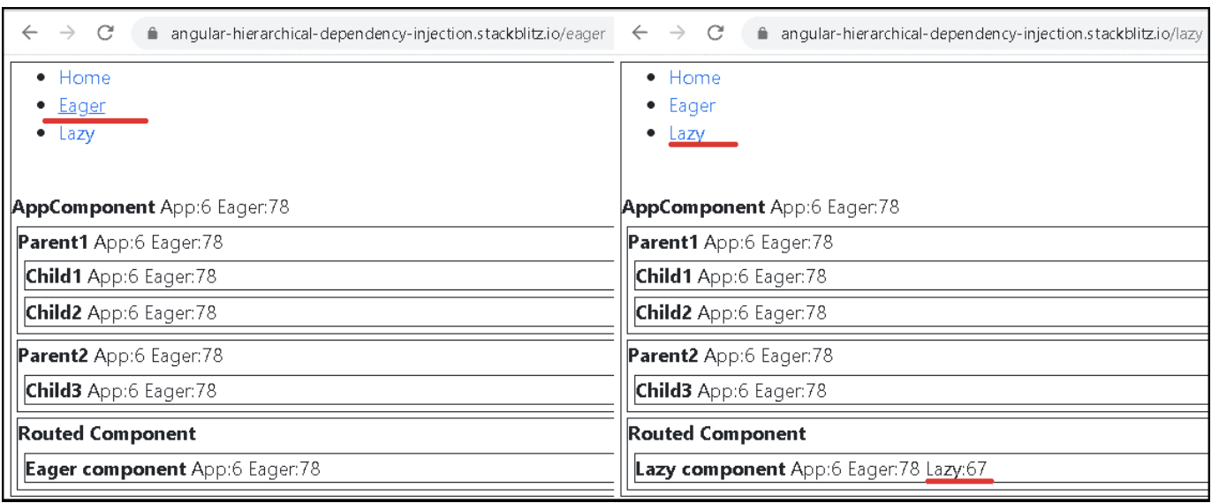
How Dependency Injection & Resolution Works in Angular
https://www.tektutorialshub.com/angular/how-dependency-injection-resolution-works-in-angular/

Slide 47
Setup example
The App has a RootModule, EagerModule & LazyModule.
All the modules have one service each. Each generates a random number. We affix the number with the name of the service so that you will know the service has generated it.
All Components inject all services and display the result.

Slide 48
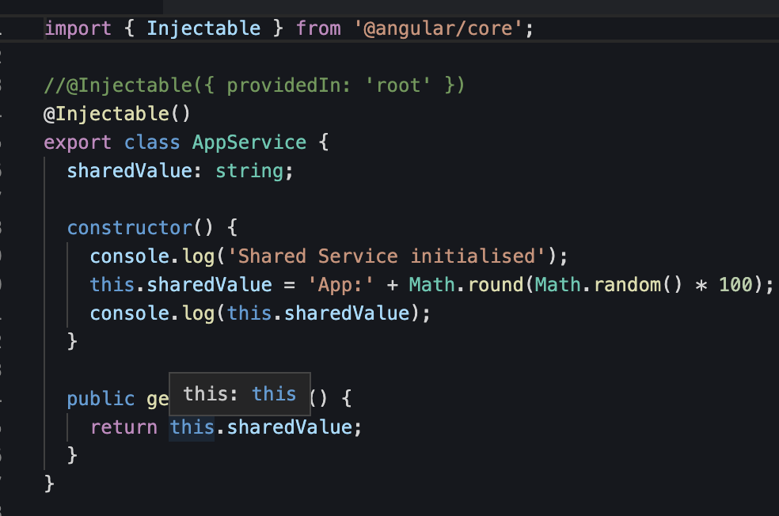

Slide 49
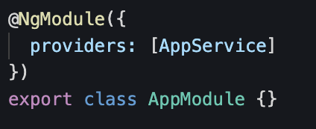
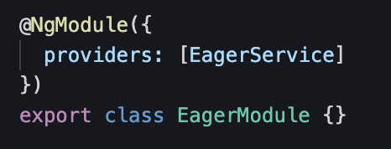
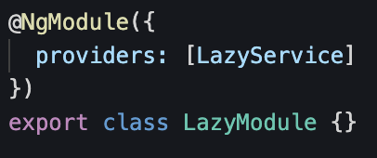
Scenario 1: Provide Services in the respective Modules
AppModule
EagerModule
LazyModule

Slide 50
Result 1
AppService & EagerService returns the same value everywhere because they are available in the RootModule Injector.
LazyService is available only in the LazyModule Injector.
→ Hence available only in the LazyComponent

Slide 51
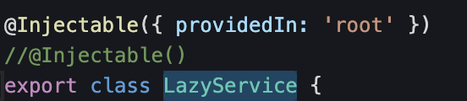
Scenario 2: Using ProvidedIn in LazyService
Add the providedIn: 'root' for the LazyService. Now LazyService is added to Root Module Injector.
Remove LazyService from the Provider’s Array of LazyModule

Slide 52
Result 2
Since the LazyService is now available Root Module Injector, it will be available across the application as a singleton

Slide 53
Scenario 3:
Keep the providedIn: 'root' for the LazyService.
Add LazyService to the Providers array of the LazyModule.

Slide 54
Result 3
Now LazyService available at 2 Injectors:
In RootModule Injector & in
LazyModule Injector.
The LazyComponent will use the service from the LazyModule Injector, while the rest of the App uses it from the RootModule Injector. Hence you get two different values

Slide 55
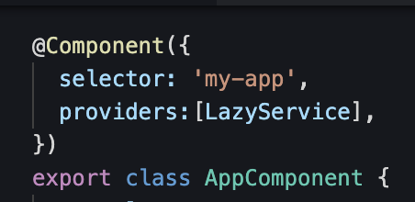
Scenario 4: LazyService in AppComponent
Keep the providedIn: 'root' for the LazyService.
Add LazyService to the Providers array of the LazyModule.
Add LazyService to the Providers array of the AppComponent.

Slide 56
Result 4
Now LazyService available at 3 Injectors:
RootModule Injector,
LazyModule Injector &
AppComponent Injector.
The AppComponent Injector is the root of the Element Injector Tree.
All Components are children of the AppComponent. Hence all of them get the same value.

Slide 57
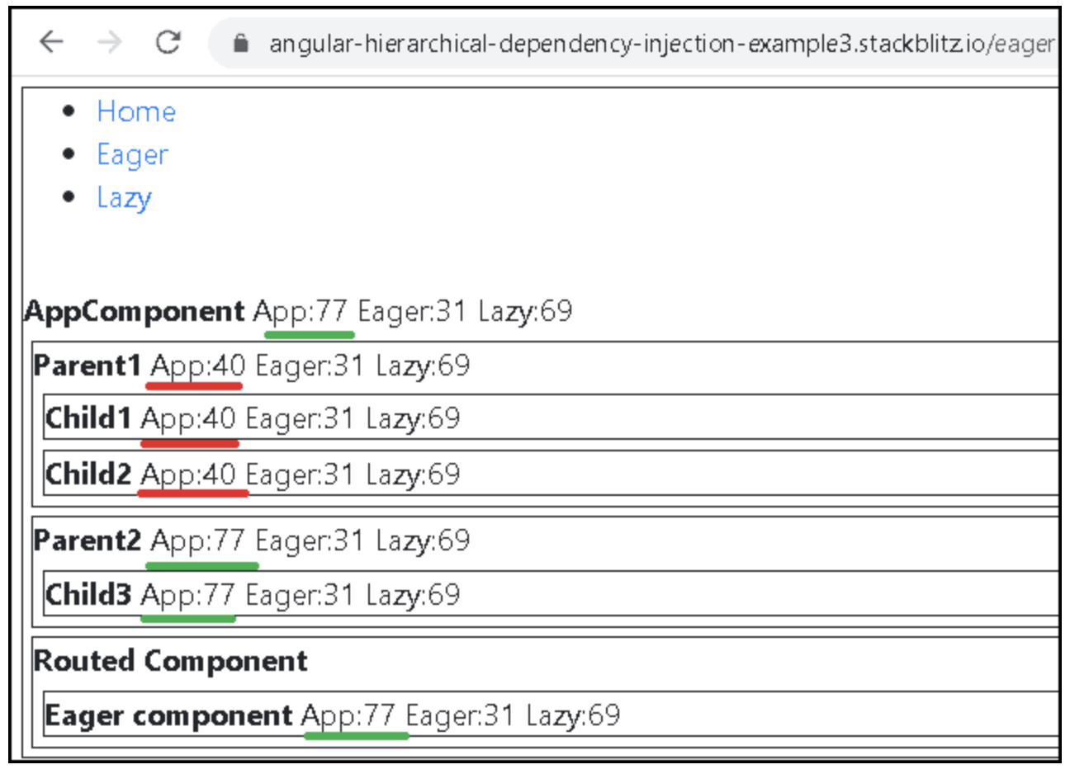
Scenario 5: Services in a Component
Register the AppService in the Providers array of Parent1Component.
As you can see from the image below, the Parent1Component & all its child components gets their copy of AppService from the Parent1Component while rest of the App gets it from AppModule

Slide 58
Resolution Modifiers

Slide 59
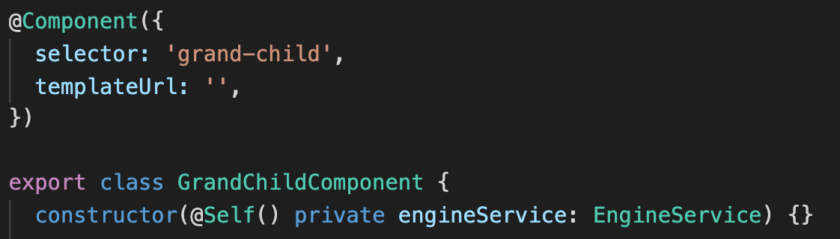
Element Injector Hierarchy
Element Injector
This component has no providers configured
@Self
@Self tells Angular that it should only look within the local injector on the current element. If there is no provider found throw an error.
ERROR
Child Element Injector
This component has no providers configured
Grand Child Element Injector

Slide 60
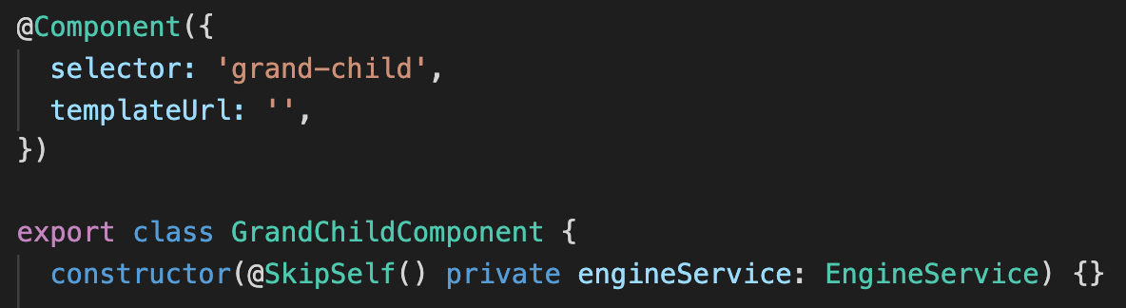
Element Injector Hierarchy
Element Injector
This component has no providers configured
@SkipSelf
@SkipSelf tells Angular that it should skip local injector and start traversing the injector tree from the parent injector.
Child Element Injector
This component has no providers configured
Grand Child Element Injector

Slide 61
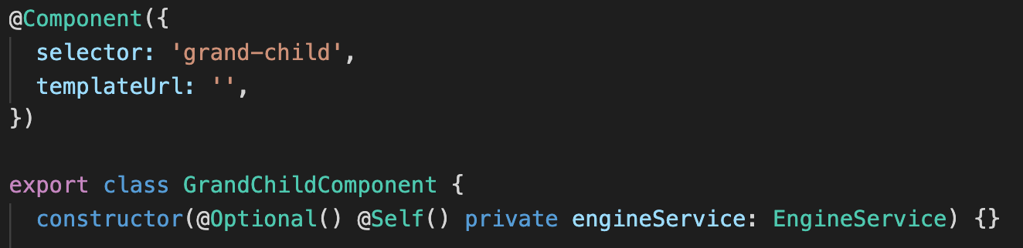
Element Injector Hierarchy
Element Injector
This component has no providers configured
@Optional
@Optional tells Angular that it should not throw the error if there is no provider and just returns NULL
Child Element Injector
This component has no providers configured
Grand Child Element Injector

Slide 62
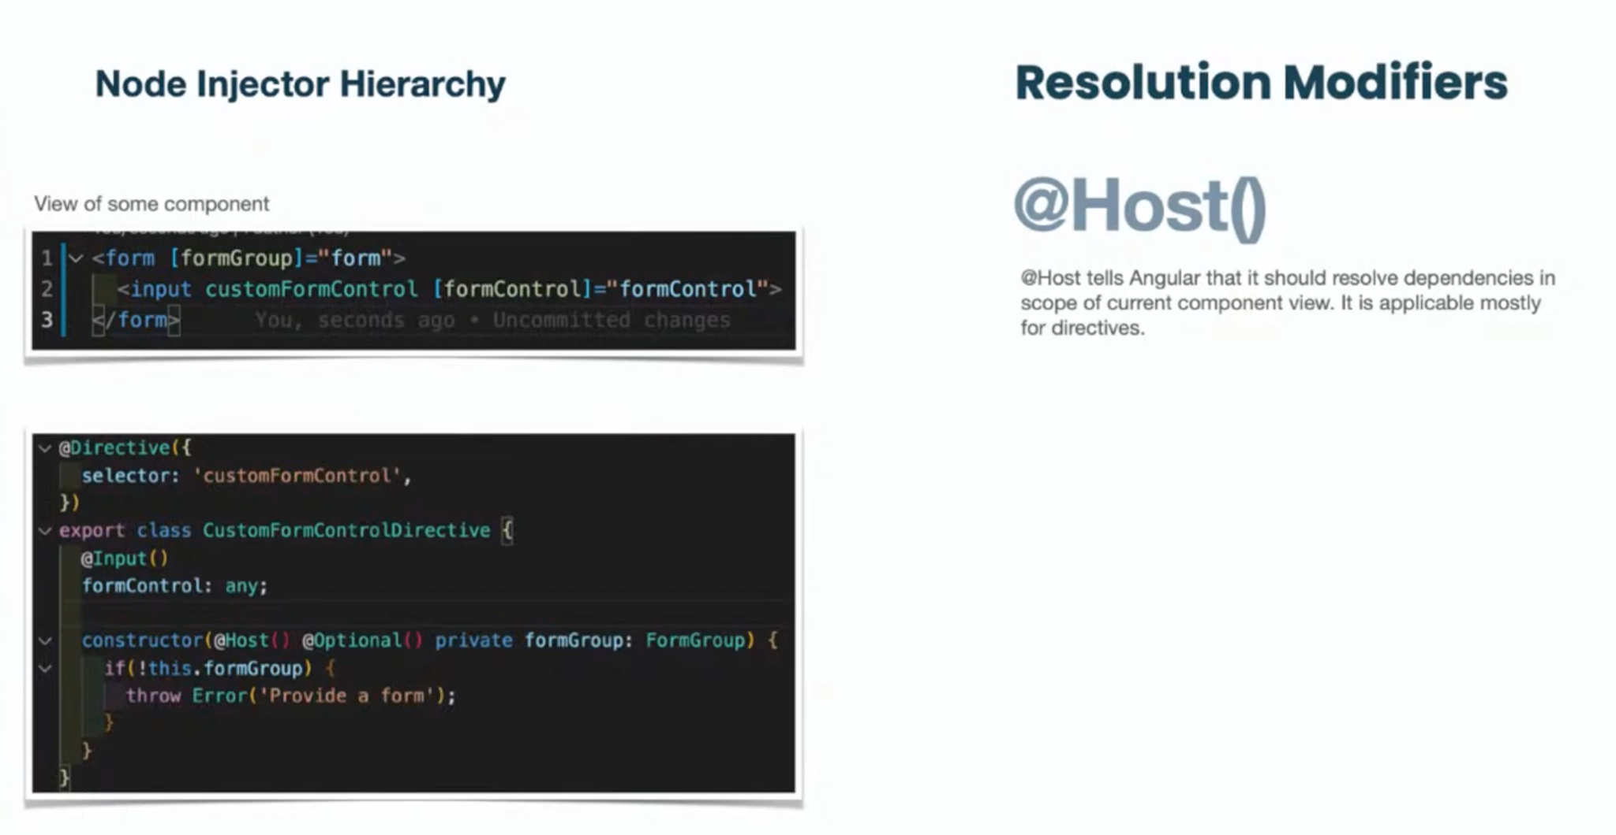

Slide 63
Dependency Providers
Notes:
https://www.tektutorialshub.com/angular/angular-providers/

Slide 64
Dependency Providers
useClass
useExisting
useValue
useFactory

Slide 65
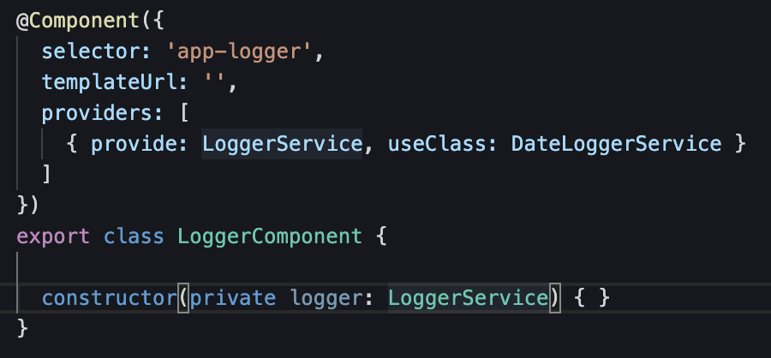
useClass in @Component
Provides a new instance of a certain class
Providers
Injector
InjectionToken
Dependency
Notes:
Token
This uniquely identifies something that we want injected. A dependency of our code.
Dependency
The actual code we want injected.
Provider
This is a map between a token and a list of dependencies.
Injector
This is a function which when passed a token returns a dependency (or list of dependencies).

Slide 66
InjectionToken
Notes:
The Angular provides InjectionToken class so as to ensure that the Unique tokens are created.
The Problem with the string tokens is that two developers can use the same string token at a different part of the app. You also do not have any control over the third-party modules, which may use the same token. If the token is reused, the last to register overwrites all previously registered tokens.

Slide 67
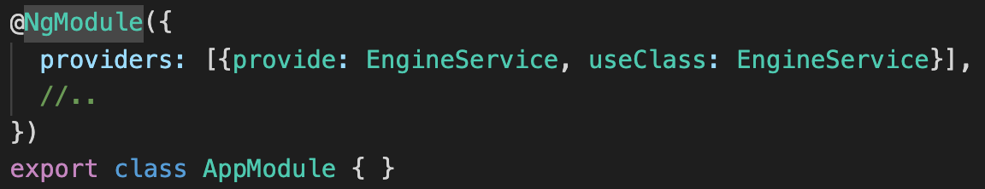
useClass in @NgModule
Notes:
Provide
The first property is Provide holds the Token or DI Token. The Injector uses the token to locate the provider in the Providers array. The Token can be either a type, a string or an instance of InjectionToken.
Provider
The second property is the Provider definition object. It tells Angular how to create the instance of the dependency. The Angular can create the instance of the dependency in four different ways. It can create a dependency from the existing service class (useClass). It can inject a value, array, or object (useValue). It can use a factory function, which returns the instance of service class or value (useFactory). It can return the instance from an already existing token (useExisting).

Slide 68
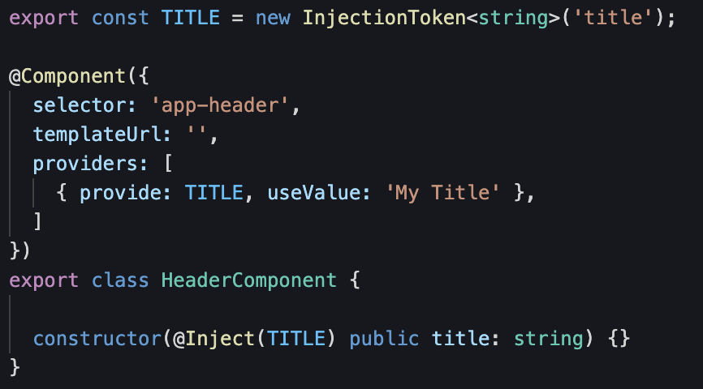
useValue
If you need to provide some value, like:
a string, object, an already instantiated class instance

Slide 69
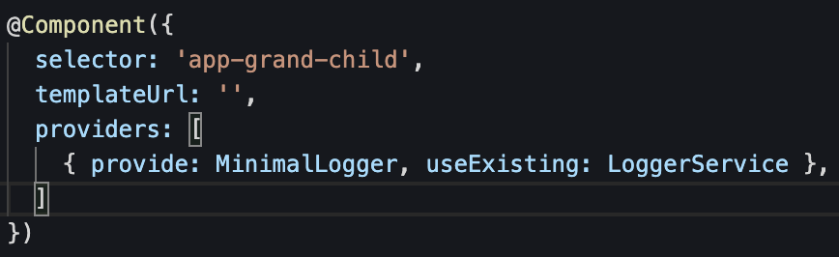
useExisting
Works as an alias,
It does not create a new instance, but use already instantiated one

Slide 70
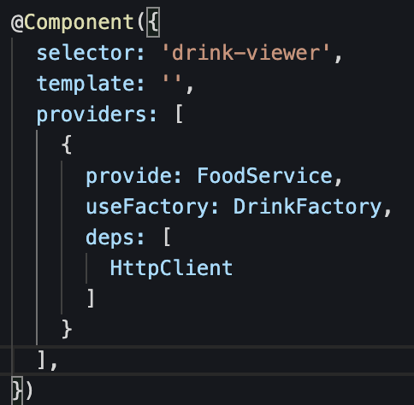
useFactory
When you have to perform some additional logic
to create an instance of a provider at Runtime!
Notes:
Use useFactory when the injection value should be computed at runtime,
provide: configure the token that will be used in dependency injection.
useFactory: configures a factory method that can return objects, string, array, etc.
deps: configures the token that the injector will use to provide the dependency injection required by the factory method.

Slide 71
code example useFactory
https://stackblitz.com/edit/ua-providers-and-usefactory

Slide 72
Live example
https://angular.io/guide/dependency-injection-in-action

Slide 73
Lessons learned

Slide 74
Wrapping up
DI is a way of architecting an application
Inversion of Control
DI framework in Angular consists of 4 concepts
DI Hierarchy (scope injected services)
Resolution Modifiers
Dependency Providers
Notes:
Dependency Injection is a way of architecting an application so code is easier to re-use, easier to test and easier to maintain.
It’s a method of decoupling a piece of code from the dependencies it needs in order to run.
It uses Inversion of Control so the responsibility of creating dependencies and and passing them in to dependent pieces of code is handled by something else.
Angular comes with a Dependency Injection (DI) framework of its own and it’s used throughout Angular’s code.
To understand how to use Angular and architect your application you need to have a very good understanding of the DI framework.
The DI framework in Angular consists of four concepts working together:
Token
This uniquely identifies something that we want injected. A dependency of our code.
Dependency
The actual code we want injected.
Provider
This is a map between a token and a list of dependencies.
Injector
This is a function which when passed a token returns a dependency (or list of dependencies).
We configure injectors with providers, Angular then uses these injectors to resolve dependencies using tokens and injecting them into constructors as arguments.
There are four types of providers: a class provider, a value provider, a factory function provider and an alias provider.
If we want a dependency to be shared across our entire application we would configure it on our NgModule.
If we want a separate instance of a dependency to be shared across each instance of a component and its children, we configure it on the component’s providers property.

Slide 76
Questions ?

Slide 77
Folder structure Angular App

Slide 78
Folder structure Angular App
See:
https://www.tektutorialshub.com/angular/angular-folder-structure-best-practices/

Slide 79
App
The App Module contains the BrowserModule and the CoreModule.
The Core submodule must be imported once in the root AppModule!
The Core submodule may not be imported into other modules!

Slide 80
Core
The Core submodule contains all app-level components and singleton services. It is the 'starting point' of the application!
Examples of app-level components/module are the: RoutingModule.
Examples of singleton services are: the Logging Service, AuthService and HttpClientModule.
Restrictions:
This Core submodule must be imported once in the root AppModule!
This Core submodule may not be imported into other modules!

Slide 81
Feature
The Feature submodule contains all components and modules with business functionality.

Slide 82
Shared
The Shared submodule contains directives, pipes, components and other modules that are shared throughout the application. The CommonModule of Angular is also an example of this and provides, among other things, the directives: ngIf and ngFor! Another example of a shared component is the Material Module.
What would you NOT put in the Shared submodule? You should not put services in a shared module which may be imported by a lazy loaded module. When a lazy loaded module imports a module which provide a service, angular will create another instance of this service which may result in unexpected behaviors.
HttpClientModule should NOT be defined in the SharedModule, because it is a singleton service!

Slide 83
class Engine { }
class GasEngine extends Engine {}
class Car {
engine: Engine;
constructor(engine: Engine) {
this.engine = engine;
}
}
const car = new Car(new GasEngine());

